Slide 1
Course Name: Computer Interfacing
Course Code: CSE-415
Credit Hour: 3.00

Slide 2
Text Books
Microprocessors and Interfacing
  Douglas V Hall
Computer Peripherals
Barry M Cook & Neil H White
The Intel Microprocessors
  Barry B Brey

Slide 3
Digital Interfacing
Methods of Parallel Data Transfer
  Simple I/O –Switch/LED
  Simple Strobe I/O – Keyboard, faster
  Single Handshake I/O – Strobed input
  Double Handshake I/O – More coordination

Slide 4
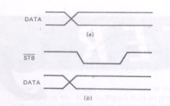
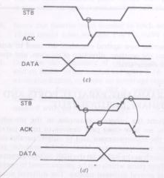

Slide 5
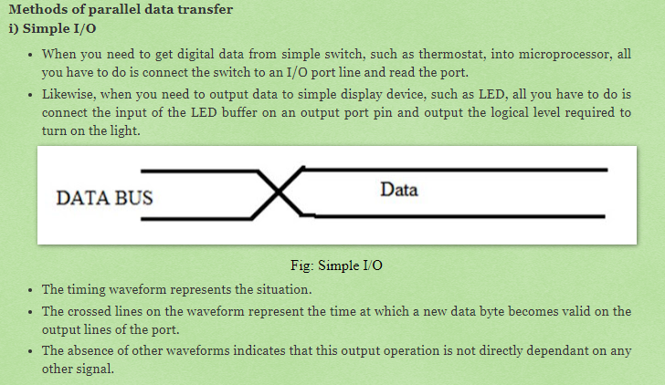

Slide 6
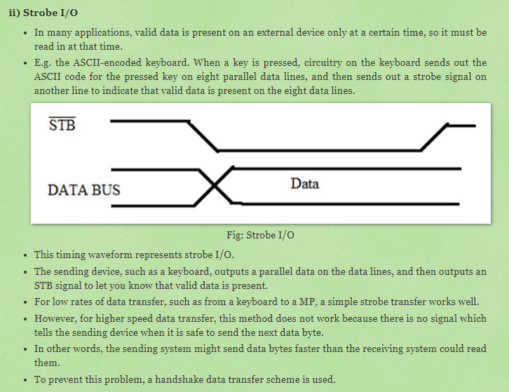

Slide 7
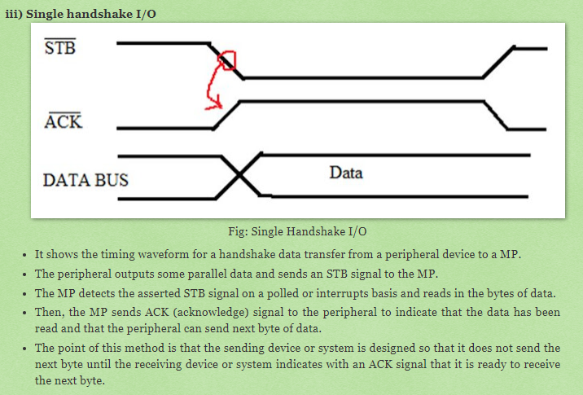

Slide 8
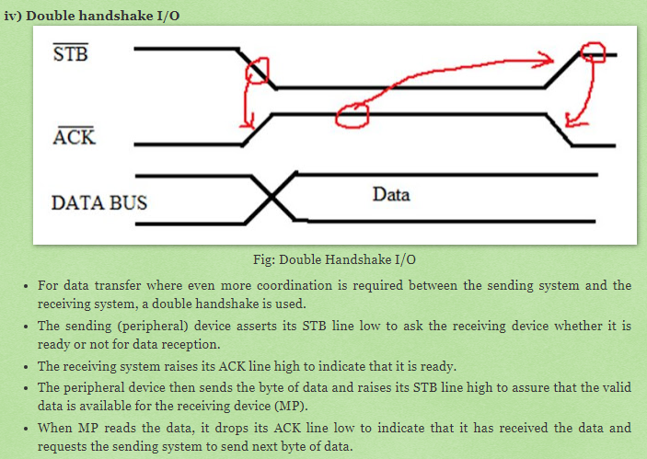

Slide 9
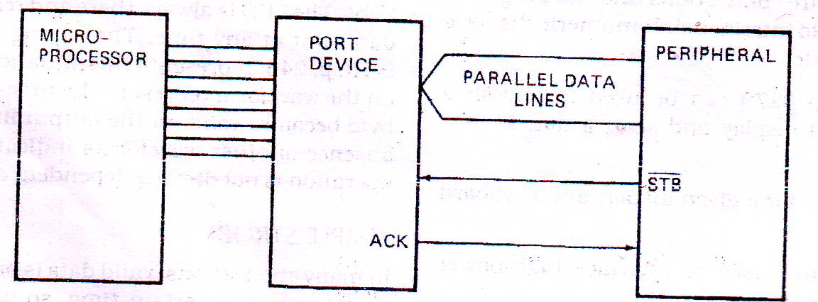
Handshake or Strobed input from the viewpoint of microprocessor

Slide 10
Parallel Printer Interface
Common printers
  IBM PC printers
  Epson dot-matrix printers
  Panasonic dot-matrix printers
Data to be printed is sent to the printer as ASCII characters on eight parallel lines
Printer receives and stores in internal RAM buffer
When printer detects a carriage return character, it prints and continue upto the end.
Transfer of character between microprocessor and printer in handshake basis. – Buffer full or faster
Standard – Centronics Parallel Interface

Slide 11
Centronics Parallel Interface
36 pin connections
Lot of pins to send a ASCII character
Data and signal line has own individual ground return line – noise reduce
Major Control Signals
  INIT (Internal Initialization) Pin No 31, Pulse Width 50 microSec
  STROBE (Tells the printer- a character is sent) Pin : 1 & 19, ).5 microSec
  ACKNLG (Data character has been accepted and printer is ready for next character) Pin : 10
  BUSY: Pin No: 10
  PE – out of paper - Pin No: 12
  ERROR – Pin No: 32

Slide 12
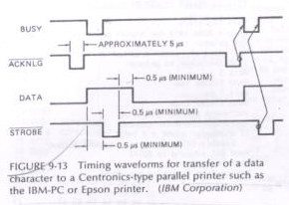
Timing Waveforms

Slide 13
Interfacing a Microprocessor to Keyboards
Key Switches
  Mechanical Key Switches
    When key is pressed -two pieces of metal are pushed together .
    Switch elements are often made of a phosphor-bronze alloy with gold plating on the contact areas.
    Contains a spring to return the key to the non-pressed position & a small piece of foam to help damp out bouncing.
    Inexpensive
    contact bounce, oxidized, not dependable
    Lifetime- 1 million keystrokes
  Membrane Key Switches
    Consists of a three layer plastic or rubber sandwich
        The top layer- conductive line of a silver ink running under each row of keys
        The Middle layer has a hole under each key position
        The bottom layer- conductive line of a silver ink running under each column of keys
    Very thin, sealed units
    lifetime varies

Slide 14
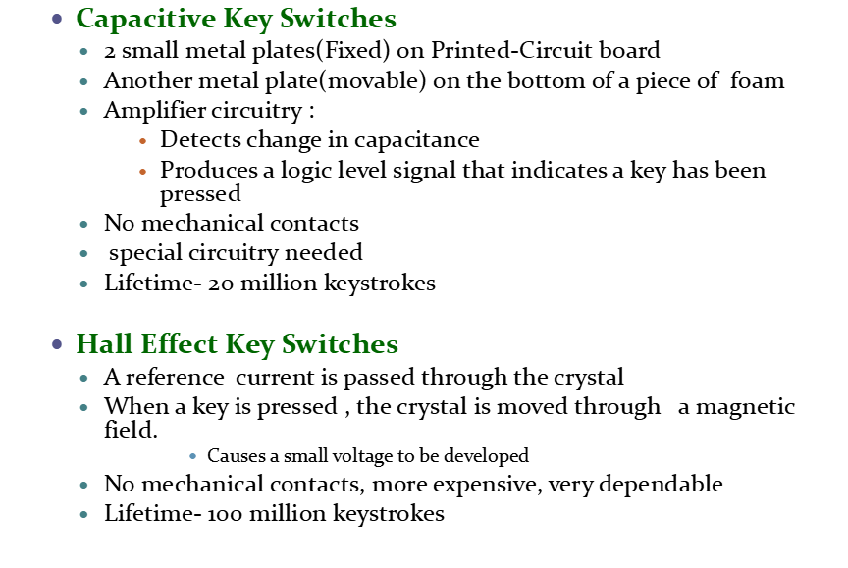

Slide 15
